Slide 1
Java Course Introduction
Università di Modena e Reggio Emilia
Prof. Nicola Bicocchi (nicola.bicocchi@unimore.it)

Slide 2
What?
Object-oriented programming (OOP) is a programming paradigm based on the concept of class objects, which can contain both data and code
Data in the form of variables (known as attributes)
Code in the form of functions (known as methods)
Java and Python are among the most prominent languages in the field

Slide 3
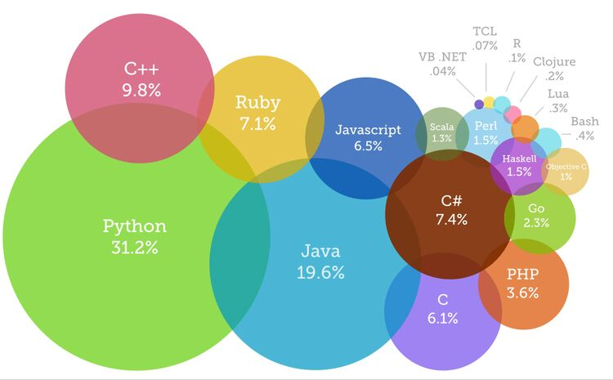
Why?
OOP followed Procedural Programming due to serious limitations affecting large-scale projects
OOP is the de facto standard for industrial software
Building modern applications almost always requires OOP languages such as Java, Python, C#, C++

Slide 4
How?
https://github.com/nbicocchi

Slide 5
When?
Wednesday 12.00 - 14.00
Thursday 12.00 - 14.00
Friday 14.00 - 17.00 (Lab)

Slide 6
Exam?
Oral examination about OOP and the Java and Python languages (short written exercises might be used)
Discussion about the structure and engineering choices of the home project written in Java or Python (1000-3000 SLOC)

Slide 7
Environment Configuration

Slide 8
Installation
Clean machine
Uninstall all previous versions of Java
Uninstall all previous versions of IntelliJ
Reboot machine
Download and Install (in this order!)
Java SE 17 (https://www.oracle.com/java/technologies/javase/jdk17-archive-downloads.html)
Intellij (https://www.jetbrains.com/idea/)

Slide 9
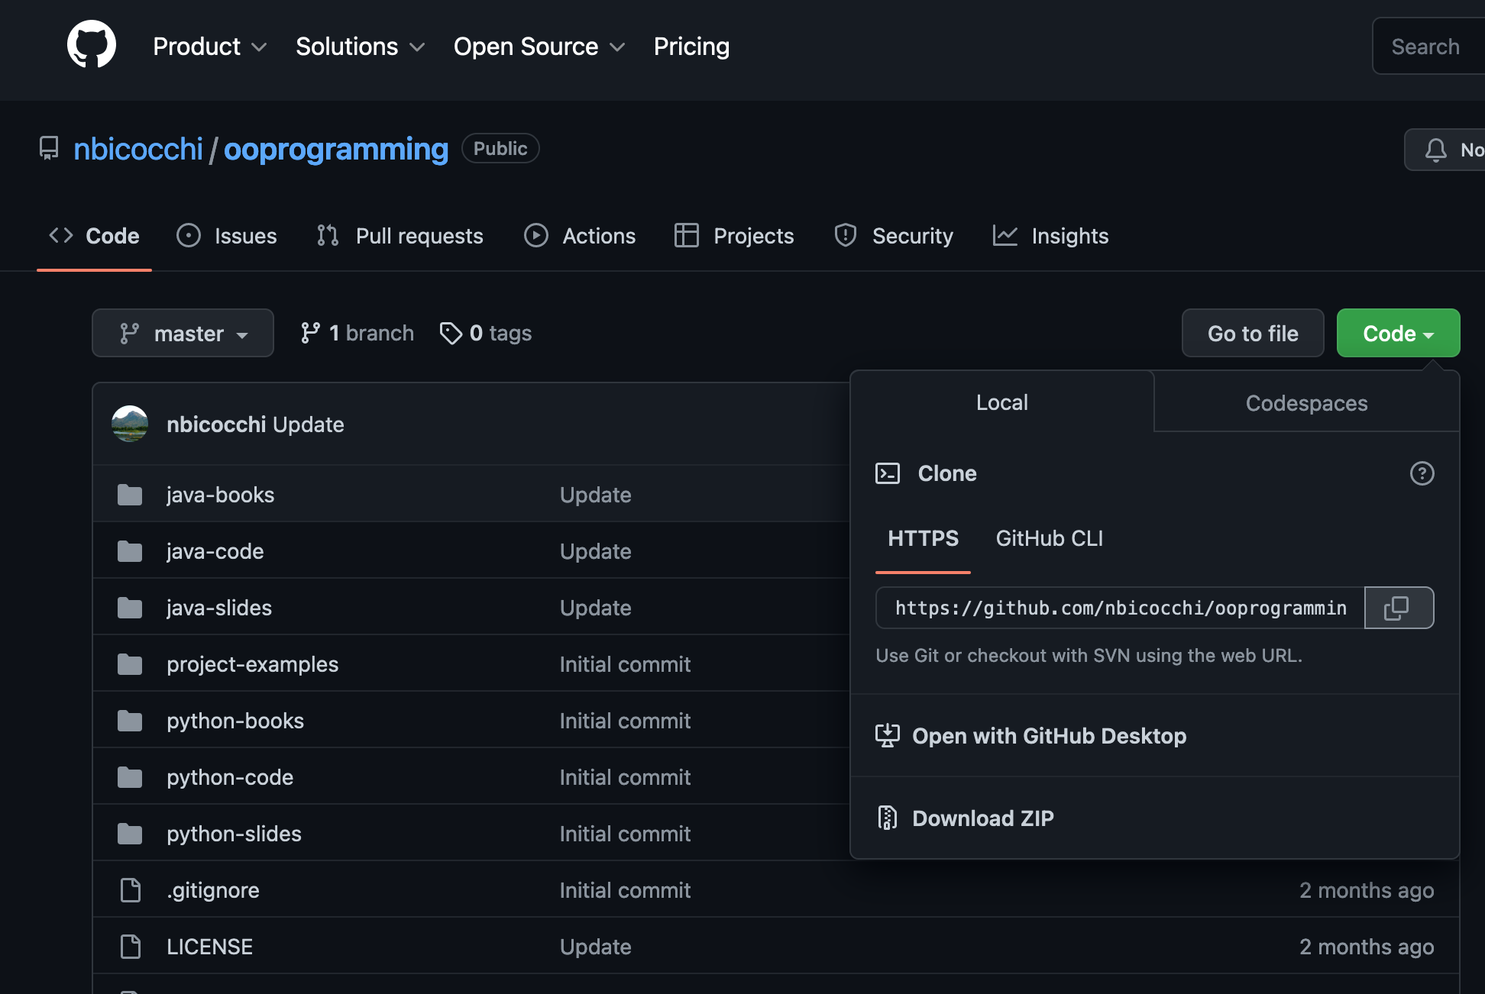
Github

Slide 10
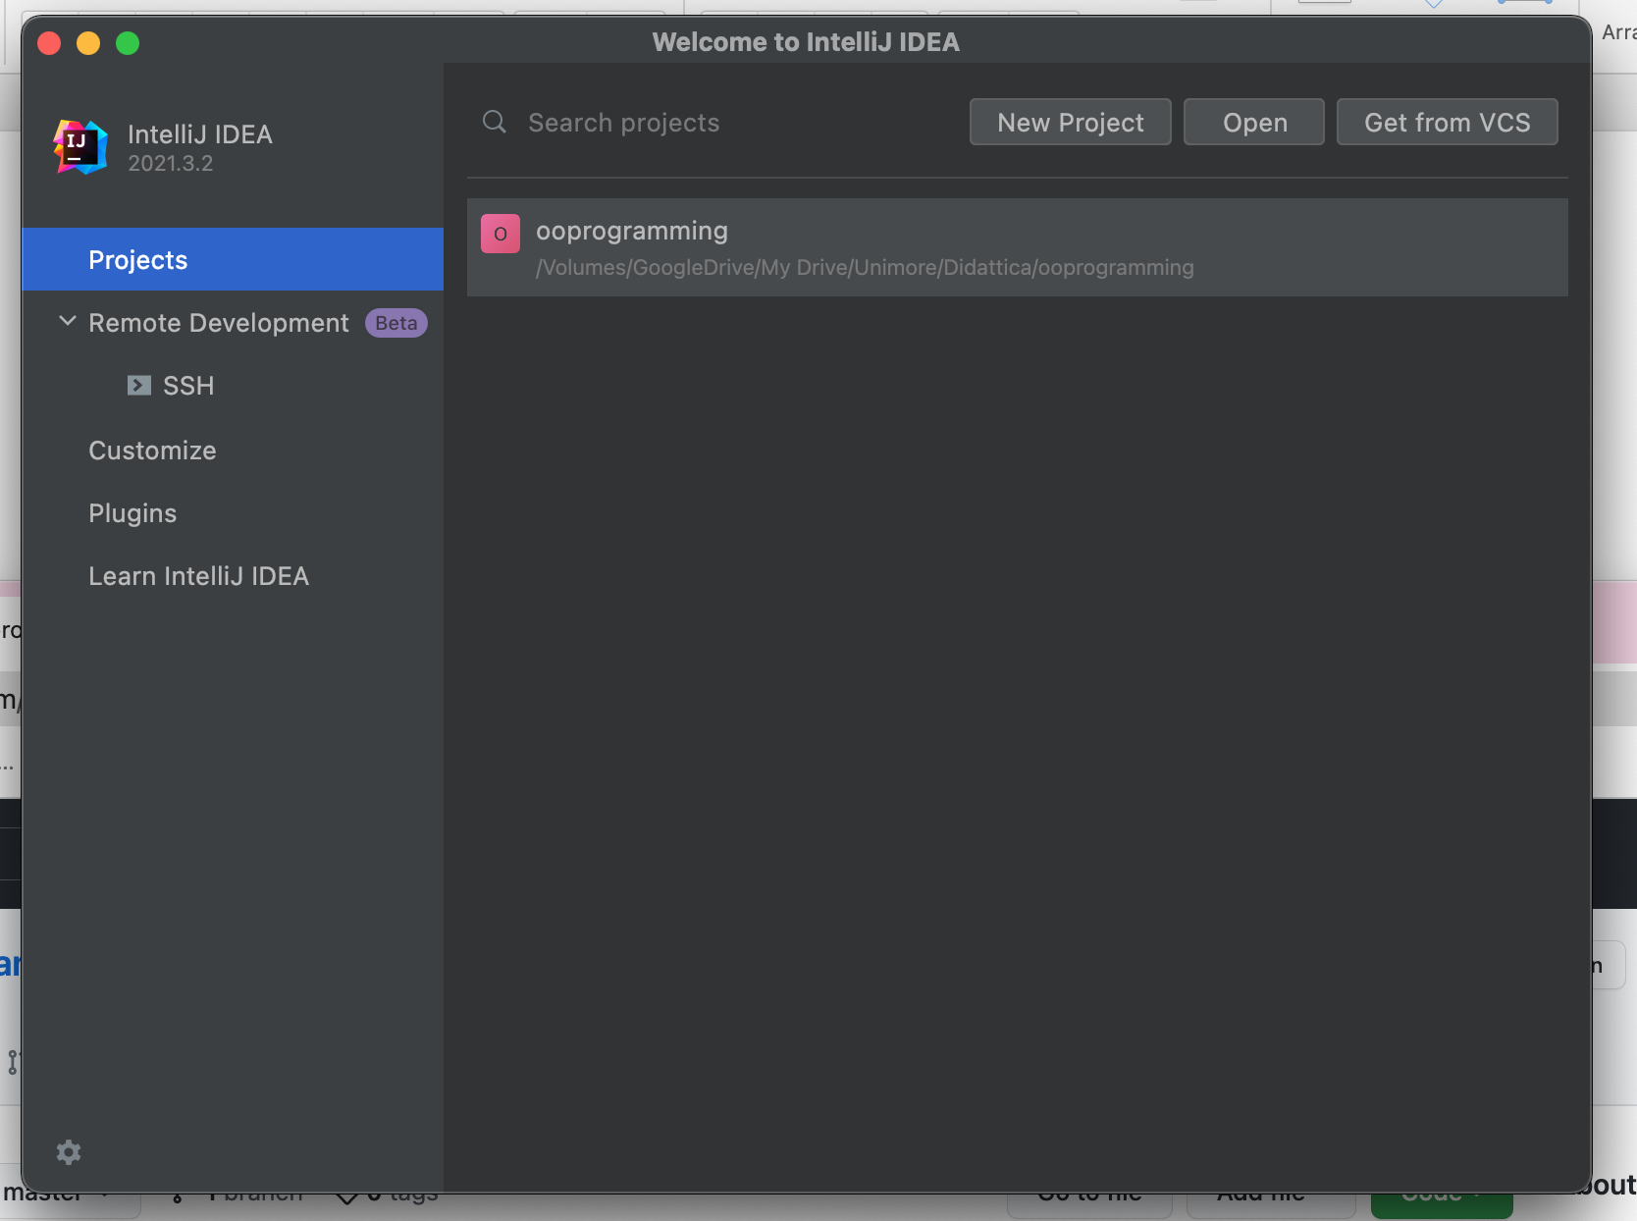
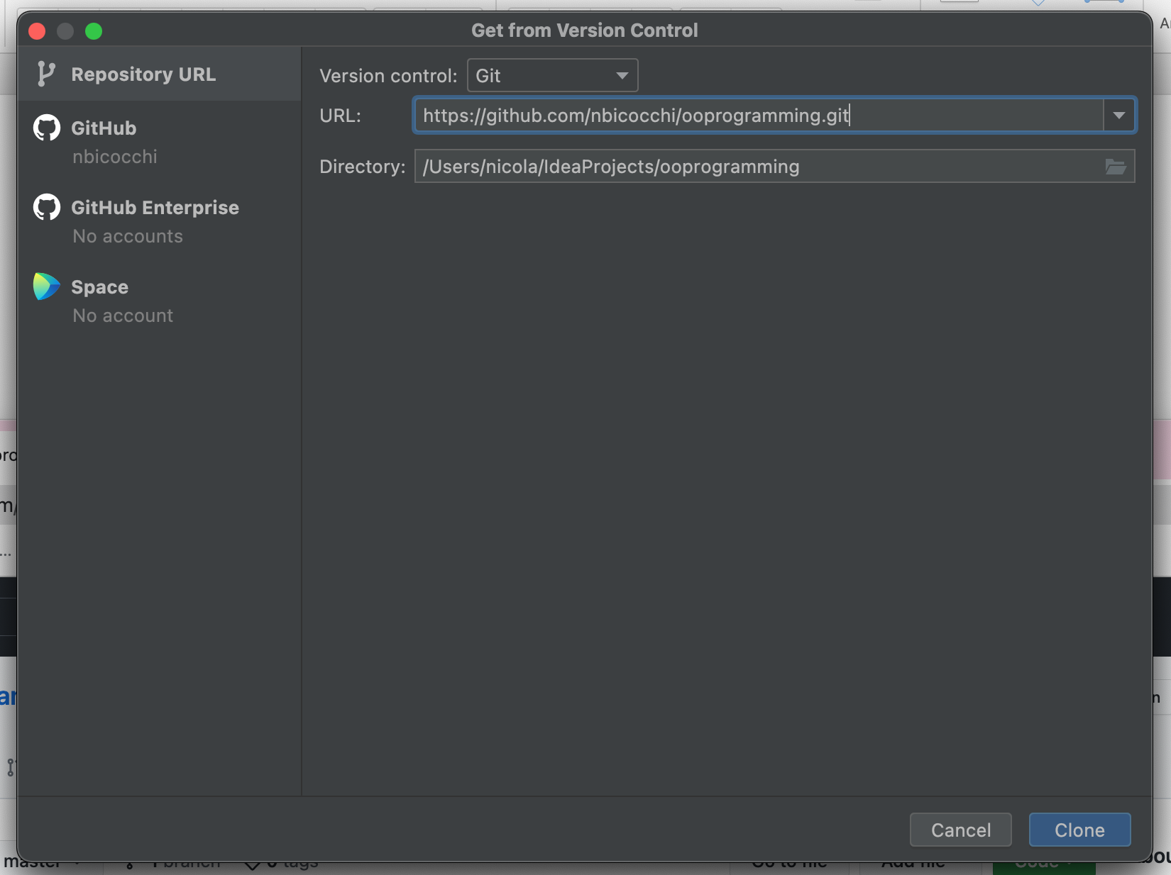
IntelliJ Idea

Slide 11
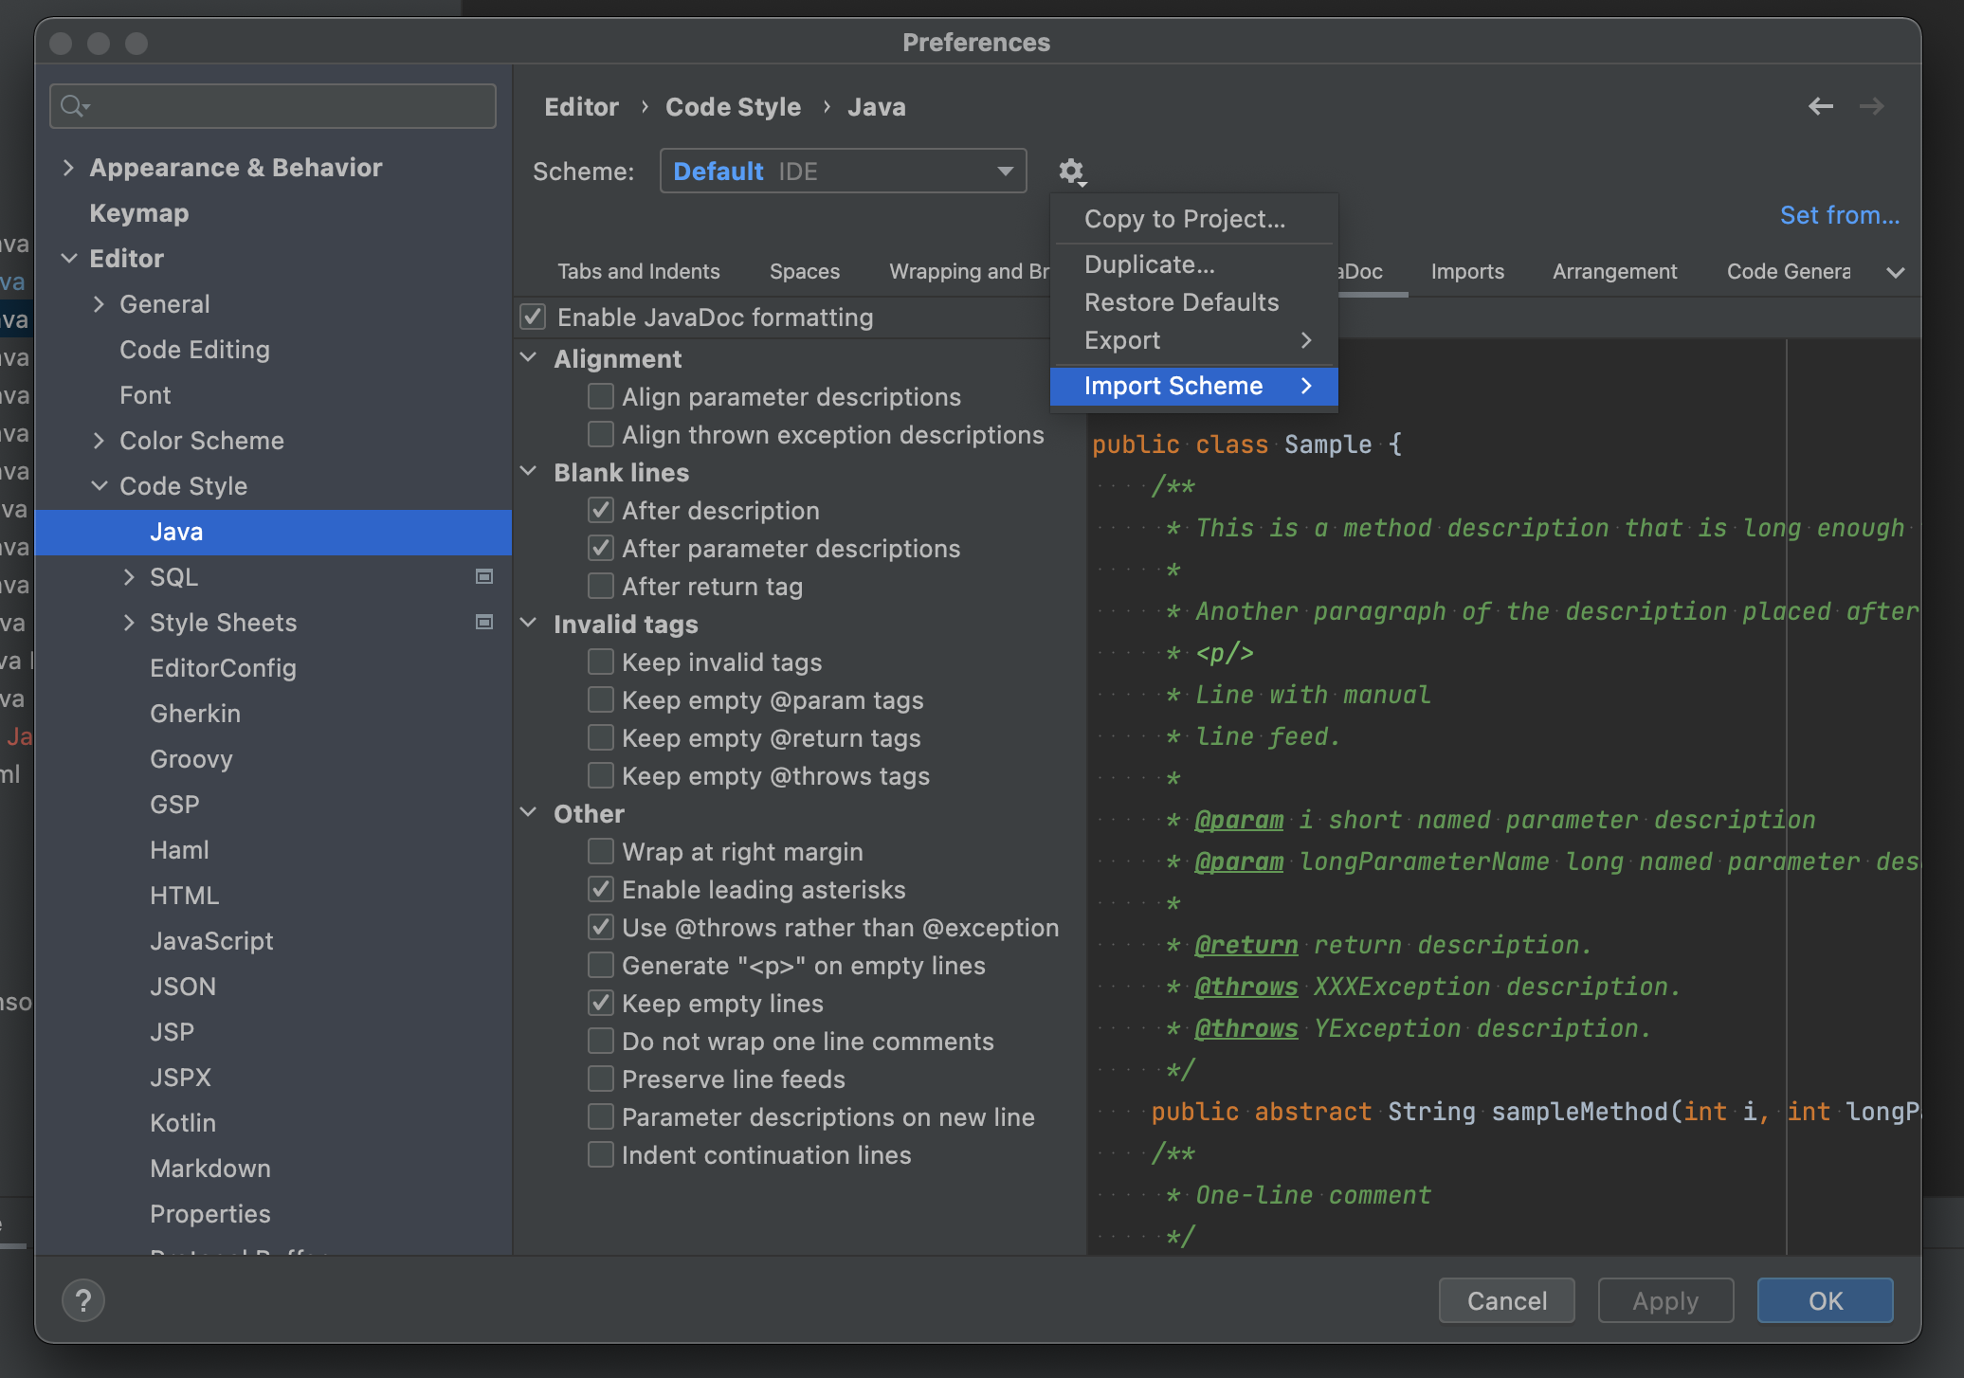
Preferences -> Editor -> Code Style -> Java
Import intellijOOP.xml (located in ooprogramming/java)

